Slide 1
Space elevator
Student’s name

Slide 2
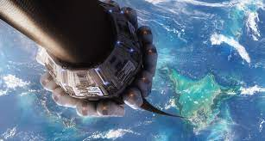
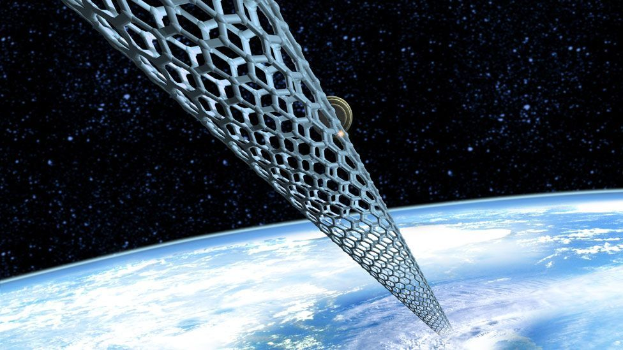
Concept
  According to Nixon, the idea of a space elevator is a more convenient alternative to entering space (Peterkin, 2018).
  Currently, the only way to get to space is through a ride on a rocket.
  It is like imagining a cable that comes from the satellite in space to the ground on earth.
  The concept seems like a fairy tale or sci-fi dream
  The concept goes that a cable drops from the satellite down to the ground and is visible.
  One can grip it and use it to climb and eventually reach the space.
  Space elevator consists of a tether 100,000km long moving along the geosynchronous orbit (GEO) and goes down to the ground.
  The dream could be realized sooner due to the current technological capability and other resources.
  Konstantin, a Russian space scientist, visualized the French Eiffel Tower extending far outside earth's orbit into space and beyond (McFall-Johnsen, 2019).
  Yuri N Artsutanov’s concept was based on a tensile structure that uses the geostationary satellite in space as the base to anchor the cable that would roll down to the ground on earth (Williams, 2020).

Slide 3
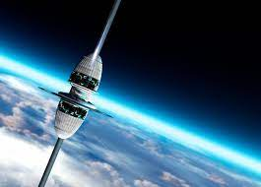
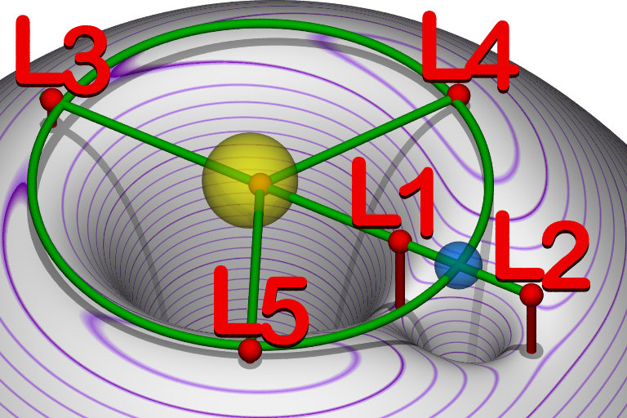
Technology
  The technology behind the space elevator involves a cable that stretches from the earth to space that provides a way to climb to orbit (Emerging Technology from the airXiv, 2019).
  Accordingly, the centrifugal forces generated by the earth's rotation will continuously stretch the tether cable, thereby keeping it straight (McFall-Johnsen, 2019).
  Traditional space elevator models entailed a tether cable anchored on earth and stretched into space, where it is connected to a counterweight to maintain centrifugal forces (McFall-Johnsen, 2019).
  In traditional earth-based models, space elevators make a complete rotation daily along with that of the earth (Emerging Technology from the airXiv, 2019).
  The moon-based space elevator is expected to orbit only once each month, which is a significantly lower frequency with fewer forces being needed to maintain the rotation of the space elevators (Emerging Technology from the airXiv, 2019).
  The space elevator would be constructed to enable the moon-based spaceline to rotate once a month while the elevator completes its rotation every day.
  Scientists have determined that it is possible to make the spaceline pass through a point where the terrestrial and lunar gravity.
  With this technology, the Lagrange point becomes the central feature of building the spaceline.
  Space elevators will also require fast propulsion systems that will mainly depend on electromagnetic forces (Patel, 2021).
  These systems will utilise electromagnetic propulsion in launching objects into space along high-speed launch rails (Patel, 2021).
  Scientists have determined four essential elements for constructing a space elevator; the base station, the counterweight, the orbital space station, the tether, and the climber (Peterkin, 2018).

Slide 4
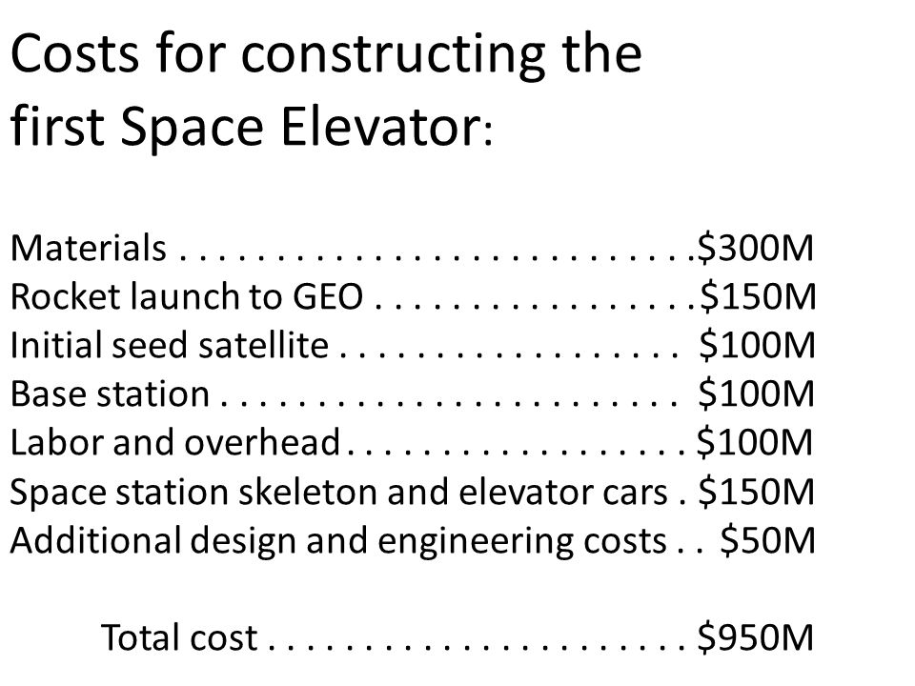
Financial viability
  One of the biggest challenges that have reduced the realisation of the space elevator's construction is the cost involved.
  Constructing the different components of the space elevator would take years and billions of dollars.
  The ISEC team estimated that constructing an elevator would take 20 years with approximately $20 billion to build tether, another component requiring around $80 billion (Peterkin, 2018).
  With the development of technology, more promising results are coming, reducing the cost or making this dream a reality.
  The only challenge that has reduced the possibility of making this dream a reality is the cost involved in constructing a space station and anchor, the counterweight, the climber, and the tether.
  While the construction of this spaceline may be expensive, evaluators who have undertaken the study on space elevator construction have determined that this sci-fi dream would help reduce the cost of transporting cargo and even people into space.
  Optimal space elevator designs may cut down more than ninety-five per cent of the current cost for cargo transportation in space (McFall-Johnsen, 2019).

Slide 5
Safety issues
  One of the other concerns about space elevators is safety.
  To deal with the safety concerns, scientists have been arguing about the suitable material that would guarantee strength to hold such vast weight and the safety of those who use it to climb to space.
  The main issue is the material producibility that can withstand the force, length, and perfection required to build a 100,000km long tether from the earth to space.
  As Peterkin (2018) explains, tether needs to be strong, which means that the entire length of the structure needs to be made from strong material and yet light enough to allow movement across space.
  As Peterkin (2018) explains, tether needs to be strong, which means that the entire length of the structure needs to be made from strong material and yet light enough to allow movement across space.
  an earth-based space elevator will have to contend with the earth's massive gravitational forces, which undoubtedly overwhelm the currently available materials (McFall-Johnsen, 2019).
  the tether material has to withstand collisions with foreign space bodies and have a consistent maintenance program to assess and repair any significant damage.

Slide 6
References
Emerging Technology from the airXiv. (2019, September 12). "A space elevator is possible with technology researchers say (we just need to dangle it off the moon)." Technology Review. https://www.technologyreview.com/2019/09/12/102622/a-space-elevator-is-possible-with-todays-technology-researchers-say-we-just-need-to-dangle/
McFall-Johnsen, M. (2019). A giant elevator could connect earth to space using current technology, experts say — here's how that might work. Business Insider Africa. https://africa.businessinsider.com/tech/a-giant-elevator-could-connect-earth-to-space-using-current-technology-experts-say/yz4czwm
Patel, M. (2021). Audacious and Outrageous: Space Elevators. NASA Science. https://science.nasa.gov/science-news/science-at-nasa/2000/ast07sep_1
Peterkin, Z. (2018, August 1). "Space Elevator Technology and Graphene." Azo Materials. https://www.azom.com/article.aspx?ArticleID=16371
Williams, M. (2020). "Going Up? The case for a Space Elevator." Herox. https://www.herox.com/blog/137-going-up-the-case-for-a-space-elevator

Slide 7


